Slide 1
WELCOMING IMMIGRANT WOMEN TO AEROSPACE
ORIENTATION

Slide 2
AGENDA
Welcome
Our Partners
Objectives of the session
Aerospace in Ontario
Employment Landscape
About the Program
Tips for Success
Q & A
Notes:
Nancy or Ginelle

Slide 3
WELCOME
INTRODUCTION
Women In Aerospace Canada along with our partners, will deliver a comprehensive suite of skills development & support to prepare under-employed newcomer women or non-binary individuals to work in aerospace manufacturing sectors in Ontario.
WHAT IS THE AEROSPACE INDUSTRY?
The Aerospace industry refers to the collection of companies, organizations and government agencies involved in research, design, production, operation or maintenance of aircraft, spacecraft, other vehicles and systems.
The Aerospace industry contributes to global transportation and commercial business.
Notes:
Nancy or Ginelle - as part of the skills development fund with the province of Ontario, the program aims to achieve successful employment of participants without any hidden fees or fine print. We are excited to bring this to you with our program partners.

Slide 4
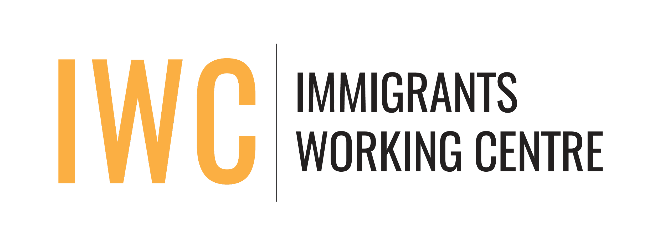
OUR PARTNERS
Women in Aerospace Canada (WIA)
WIA-Canada is a not-for-profit organization dedicated to expanding women’s opportunities for leadership and professional development as well as increasing their visibility in the aerospace community by creating a professional network in Canada and across the globe.
The Strong Link (TSL)
The Strong Link works with industry and academic partners to enable business leaders to develop the competencies needed to execute, transition and scale. We bring together over 130 leaders across multiple industries to instruct, mentor and coach real-time insights. TSL leverages industry-led instruction grounded in a design thinking approach to craft, deliver and measure impact-driven training courses and mentorship programs. Led by senior leaders from tier-1 businesses worldwide - our content conceptualizes current lessons learned, best practices and insight.
Immigrants Working Centre (IWC)
The Immigrants Working Centre (IWC) is a nonprofit, equality-seeking, anti-racism, and multi-service organization. IWC's mission is to provide innovative and integrated employment-focused settlement and language programming to support immigrants' success in a just and supportive community. IWC offers a wide range of services tailored to the unique needs of newcomers, including settlement, employment, LINC programming, community connections, and care for newcomer children.
McMaster Manufacturing Research Institute (MMRI)
MMRI has more than 20 years of experience in teaching, research, and industrial activities. We have pooled our resources including facilities, industry scale equipment, expertise, and connections to industry experts to bring together the MMRI Industrial Training Program. Our experts, in collaboration with those of our partners, created a wide range of courses applicable to many different activities within the aerospace, automotive, and many other industries.
UTIMUS
UTIMUS works to empower employment by helping newcomers enroll in programs that will give them the skills and credentials they need to find their new careers in Canada.
Notes:
Pass off and intro next speaker for each new org. i.e. “Here is Paula to speak about Immigrants Working Centre”.

Slide 5
OBJECTIVES FOR TODAY
Introduction Session designed to provide:
Basic information about the Aerospace industry in Ontario and employment opportunities
An understanding of the training program and timelines
Insights on how the program works and how to prepare for it
At the end of the session you will:
Have complete details about the program.
Be better prepared for the selection process.
Have a greater understanding of the employment support offered.
Notes:
Nancy or Ginelle. Thank you everyone, as you can see, this is a great group and we all look forward to supporting you.

Slide 6
AEROSPACE IN ONTARIO
About the industry:
The aerospace industry in Ontario is a thriving sector with a long history of innovation and growth.
The industry employs over 28,000 people in the province and contributes over $5.3 billion to Ontario's GDP.
The province of Ontario has established itself as a global leader in aerospace manufacturing, with a strong supply chain in place to support this industry.
Some of the key areas of expertise and specialization for the Ontario aerospace industry include aircraft design and certification, aircraft assembly, engines and propulsion systems, avionics, and maintenance, repair, and overhaul (MRO) services.
The aerospace industry in Ontario is poised for continued growth in the years ahead, thanks to ongoing investments in research and development, a highly skilled workforce, and a supportive business environment.
Notes:
Nancy or Ginelle. The industry is very diverse and includes aircraft supply chain to development of core systems as well as the critical support after aerospace products come into service and repair. This is only a few areas Ontario employs.

Slide 7
AEROSPACE IN ONTARIO
According to the Aerospace Industries Association of Canada (AIAC), the aerospace industry in Ontario employs over 28,000 people including more than 7,000 engineers and technicians.
The Ontario aerospace sector offers a broad range of job opportunities in fields such as:
General Labour
Engineering
Manufacturing
Maintenance
Repair and overhaul
Technology development
Opportunities are available for General Labourer positions in shipping, receiving, and production, as well as technical job opportunities as aircraft mechanics, avionics technicians, production managers and more.
There is already a community of women working in the industry.
30% of the Aerospace workforce in Canada are women
Notes:
Nancy or Ginelle - A few numbers here that show the diversity and range of job opportunities available in the industry.

Slide 8
THE EMPLOYMENT LANDSCAPE
Some of the major aerospace companies located in Ontario include:
Bombardier Aerospace - based in Toronto, they design, manufacture and support aircraft such as the Challenger, Global, and Learjet families of business jets.
De Havilland Aircraft of Canada – they design and manufacture commuter and regional aircraft and are committed to producing safe, reliable, and efficient aircraft that serve various markets around the world, including commercial, military and government customers.
Pratt & Whitney Canada - with a significant presence in Ontario, they design, manufacture and service aircraft engines, including the popular PT6 and PW100 engine families.
Honeywell Aerospace - based in Mississauga, they design and manufacture avionics and other aerospace technologies, including flight management systems, cockpit displays, and communication systems.
Notes:
Don’t need to read all descriptions. “There are a number of aerospace companies in ontario and you will learn more about them further in the program”.

Slide 9
THE EMPLOYMENT LANDSCAPE
Some of the major aerospace companies located in Ontario include:
Magellan Aerospace - based in Mississauga, they design and manufacture advanced aerospace components and systems, including aero engines, airframe structures, and space technologies.
L-3 Wescam - based in Burlington, they design and manufacture high-performance imaging and targeting systems for a variety of aerospace applications, including military and surveillance operations.
Héroux-Devtek - based in Quebec, but with a significant presence in Ontario, they design and manufacture landing gear systems for a variety of military and commercial aircraft
Fleet Canada – manufacturer of aerospace structures, component parts, and assemblies.
Notes:
Nancy or Ginelle

Slide 10
THE EMPLOYMENT LANDSCAPE
Some of the major aerospace companies located in Ontario include:
Airbus helicopter - Headquartered in Fort Erie, Ontario, Airbus Helicopters Canada is a center of excellence for engineering and composite manufacturing, and is the sole-source supplier of composite parts for eight different helicopter models in the Airbus range.
Field Aviation - design, manufacturing and delivery of specialized aircraft.
Flying Colors - Located in Peterborough, Ontario, Flying Colours provides comprehensive maintenance, repair and overhaul services, completions, refurbishments, special mission modifications, avionics upgrades and installations, exterior paintwork and aircraft transaction support.
Trinity Aerospace – based in Mississauga, they provide parts development, parts manufacturing/processing and after sales support. Trinity produces sheet metal & machined detail parts and assemblies
MHI Canada – based in Mississauga, they provide Development, manufacturing, sales, and after-sales service for aircraft
Notes:
Nancy or Ginelle

Slide 11
THE EMPLOYMENT LANDSCAPE
Potential Occupations at Aerospace Manufacturers:
Component Assembly
Machine Operator
Machine Programing
Methods Analyst
Quality Analyst
Logistics Buyer
Shipping & Receiving
Business Analyst
Administrative Worker
Communications Assistant
Notes:
Nancy or Ginelle. Here is a small list of potential occupations in the industry. There is a lot of activity around logistics and quality for this global industry. There is a common misconception that you have to be an engineer or pilot to enter this sector. This is just not true. These are only 10 examples of hundreds of occupations available in the aerospace industry. There is definitely something for everyone.

Slide 12
ABOUT THE PROGRAM
The Program is designed to assist those who identify as women and non-binary newcomers to overcome unique barriers.
Working with local employers, the program will seek to understand and respond to workforce gaps, target occupations, and the skillsets required to address them.
There are several phases within the program leading up to training, to help prepare and support participants.
Application
Selection
Preparation
Sector Orientation Workshop
Employment preparation and support
Course Selection
Training
Placement
The program is designed for all activities to be virtual, however some job fairs and certain MMRI in-person activities will be available.
Notes:
Nancy or Ginelle - This is a brief overview of our program. What is most important that we would like to stress is that we are targeting the unique barriers newcomers and non-binary newcomers may experience in Canada and how we will support to overcome these barriers. Through this program, our goal is to help achieve employment placement for as many participants as possible without any hidden agenda. Next is Emilee

Slide 13
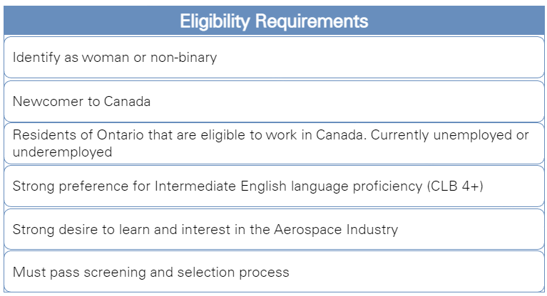
ABOUT THE PROGRAM
Application & Selection:
Ensure you fulfill eligibility criteria
Complete your online registration
Notes:
Emilee - next is Paula

Slide 14
ABOUT THE PROGRAM
Preparation:
Onboarding instructions will be provided
Advisors will be assigned to you to guide you through course selection
Sector Orientation Workshop (IWC):
These sessions are designed to:
Provide greater understanding of the job opportunities that are available in the industry
Review skills requirements
Increase participants’ understanding of the labour market
Introduce participants to the sector-specific job preparation that will be provided to them
Notes:
Paula

Slide 15
ABOUT THE PROGRAM
Employment Preparation and Support (IWC):
Delivered through group sessions and one-on-one meetings with an
Employment counsellor:
Complete a Health & Safety Training Certificate
Gain understanding of the Ontario Employments Standards
Prepare a suitable Resume and Cover Letter
Strengthen your interview skills
Enhance your occupational language skills
Notes:
Paula

Slide 16
ABOUT THE PROGRAM
Placement (IWC):
Occupation/sector-specific networking groups and events:
Virtual and in-person job fairs, networking sessions with relevant employers and associations
Facilitate connection building among program participants, who will share employment experiences and needs.
Support with onboarding and employment retention
Support for both job seekers and employers with onboarding activities
Ongoing communication with each employer and program participant to resolve any issues and respond to concerns that might impact retention
Notes:
Paula - next is Ashan

Slide 17
ABOUT THE PROGRAM
Training (TSL):
Two sessions focusing on the following:
Introduction to Aerospace
To engage, enable and orient newcomers to Canada with an overview of the functional, operational, structural, and regulatory attributes inherent to the Aerospace Manufacturing Industry.
Participants will also gain insight from industry leaders on integration best practices and sought-after skills and behaviors to best enable entry into the sector.
Workforce Virtual Mentorship Event
Utilizing a group-based approach, each participant to interact with six senior industry leaders, leveraging the skill-gap analysis to share first–hand strategies, best practices and lessons learned to better enable entry into the industry sector.
Notes:
Ashan - next is Sean

Slide 18
ABOUT THE PROGRAM
Course Selection (MMRI):
MMRI offers courses on a variety of different topics, broadly separated into different areas:
Courses are designed to develop occupation skills and are applicable to Aerospace Manufacturing, Logistics, Distribution & Technology.
Each participant is required to take a minimum of three courses from their chosen focus area, along with three other “elective” courses that can from any of the training areas offered.
Before beginning the program, participants will be referred to an advisor who they can speak to about their current knowledge, experience, and goals to help determine which stream and courses will be the best fit for you.
Materials Engineering
Manufacturing Processes
Machining
Design and Modelling
Surface Engineering
Programming
Industry 4.0
Management
Notes:
Sean

Slide 19
ABOUT THE PROGRAM
Training (MMRI):
Participants in this program will have a six week period to complete their courses, at a pace of one week per course.
Courses are delivered in asynchronous online format.
During this time, a few live sessions with instructors who created the courses will be offered as an opportunity to go further into the material, apply it in practice, and interact with the instructors.
Testing is conducted at the end of each training course.
Notes:
Sean - next is Ginelle

Slide 20
NEXT STEPS
What’s Next?
A UTIMUS advisor will contact you to confirm your interest.
A UTIMUS advisor will help complete a form on your behalf to validate eligibility.
If accepted, you will receive an email confirming acceptance to the program
You will receive an Onboarding Information Pack via email
Review the Onboarding material in detail – take note of important dates and links
Tips for Success
Commit to the Program
Do the work
Ask questions
Don’t be shy to ask for help
Use your Advisors
Research the industry to find the opportunities that will suit you best
To access this presentation, view the program timelines, and for more information click here.
Notes:
Nancy or Ginelle - Ensure you do the research to find what suits you best and where you will be engaged and interested most.

Slide 21
WELCOMING IMMIGRANT WOMEN TO AEROSPACE

